Slide 1




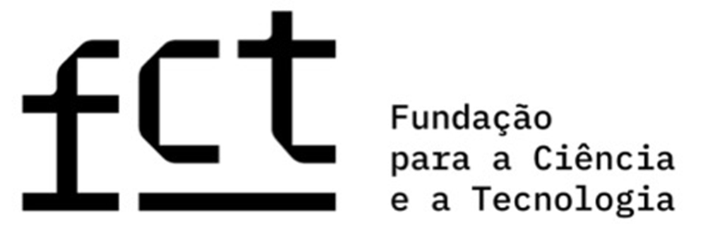




Perceptions, Knowledge and Adoption of the Mediterranean Diet Among University Students
Ada Rocha⁽¹⁾; Beatriz Neto⁽¹⁾; Francisca Costa⁽¹⁾ ; Inês Brito⁽²⁾ Marília Prada⁽²⁾ ; Cláudia Viegas⁽³⁾
⁽¹⁾ Faculdade de Ciências da Nutrição e Alimentação do Porto; Porto, Portugal; adarocha@fcna.up.pt; ⁽²⁾ISCTE – Instituto Universitário de Lisboa; Lisboa, Portugal; ⁽³⁾Escola Superior de Saúde de Lisboa; Lisboa, Portugal;
INTRODUÇÃO
The Mediterranean Dietary Pattern (MDP) is globally recognized as one of the healthiest and most sustainable eating models, strongly associated with longevity and the prevention of chronic diseases. Beyond its health benefits, its core principles contribute significantly to reducing environmental impact. However, the transition to university life often leads students to adopt poorer eating habits, characterized by an increased consumption of processed foods and a decreased intake of fruits and vegetables. In this context, university cafeterias emerge as vital settings for promoting sustainable habits through the provision of Mediterranean-aligned menus. To develop effective nutritional interventions, it is crucial to first understand how students perceive and adhere to this dietary pattern.
OBJETIVO
This study aimed to explore university students' knowledge, perceptions, and adherence to the Mediterranean Dietary Pattern, while also evaluating their acceptability of specific Mediterranean-style starters and dishes within the university canteen environment.
MÉTODOS
A qualitative study was conducted involving ten focus groups with a total of 66 university students, aged between 18 and 52 years, recruited through snowball sampling. 31 of the participants were compensated with 15€ vouchers and 35 with course credit. The primary goal was to assess adherence, knowledge, and perceptions regarding the Mediterranean Dietary Pattern (MDP).
Students were recruited trough social media and word-of-mouth referrals. The inclusion criteria were being a full-time university student, resident in Portugal for a minimum of two years and be fluent in Portuguese.
Data analysis was performed using inductive Content Analysis through MAXQDA 2024 software, following the six-phase Thematic Analysis framework established by Braun and Clarke. The initial coding process was carried out in Portuguese and subsequently translated into English for academic dissemination.
RESULTADOS
Students demonstrated varying levels of knowledge regarding the Mediterranean Dietary Pattern (MDP). While key foods such as vegetables, fish, and olive oil were frequently identified, there was significantly less awareness of core principles like seasonality, freshness, and local sourcing. The most common associations with the MDP were the concepts of a "balanced" and "varied" diet.
Barriers
The main obstacles identified were convenience factors—such as lack of time, motivation, or cooking skills—alongside personal preferences, the high cost of certain foods, and limited budgets.
Facilitators
Daily adherence is primarily driven by parental influence, established eating habits, and perceived health benefits. Additional drivers include satiety, sustainability, and ease of access.
Convenience
36%
(n=18)
Lack of time
12%
(n=6)
Difficult to cook
4%
(n=2)
Family influence
42%
(n=27)
Healthy Diet
9%
(n=6)
Easy access
3%
(n=2)
Personal preferences
26%
(n=13)
High cost
10%
(n=5)
Food
Habits
17%
(n=11)
Sustainable Diet
5%
(n=3)
Students expressed general receptiveness toward Mediterranean-style dishes, valuing visual appeal, the inclusion of vegetables, and a "homemade" feel. Mediterranean-style starters were specifically noted as innovative alternatives to traditional soup. Rejection of these options was not linked to the dietary pattern itself, but rather to personal tastes, specific ingredients, or perceived dryness of certain dishes.
CONCLUSÃO
The findings highlight that university students generally have a favorable perception of the Mediterranean Dietary Pattern and are highly accepting of Mediterranean-style options in cafeterias, despite some gaps in their understanding of the pattern’s core principles. This acceptance confirms the significant potential for implementing MDP-oriented strategies within university dining services. To improve overall adherence to this healthy and sustainable food pattern, future interventions must focus on mitigating identified barriers such as cost, convenience, and the need for improved cooking skills among students.
REFERÊNCIAS
Abuawad, B., Ellala, Z. K., El-Saleh, M., Alsalhi, N., Qatawneh, S. A., & Aljarrah, K. (2023). Student Eating Attitude and Life Style Impact on the Academic Performance: Evidence from the College Students. Eurasian Journal of Educational Research, 103(103), 18-32.
Lanuza, F., Morales, G., Hidalgo-Rasmussen, C., Balboa-Castillo, T., Ortiz, M. S., Belmar, C., & Muñoz, S. (2022). Association between eating habits and quality of life among Chilean university students. Journal of American College Health, 70(1), 280-286.https://doi.org/10.1080/07448481.2020.1741593
Lima JPM, Costa SA, Brandão TRS, Rocha A. 2021. Food consumption determinants and barriers for healthy eating at the workplace-a university setting. Foods, 10(4), 695. https://doi.org/10.3390/foods10040695.
Silva, S. S., Rocha, A., & Viegas, C. (2025). Strategies for increased adherence to the Mediterranean or healthy diet in university food services: A systematic review. International journal of food sciences and nutrition, 76(3), 239-264, https://doi.org/10.1080/09637486.2025.2472216.

