Slide 1


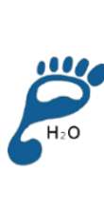


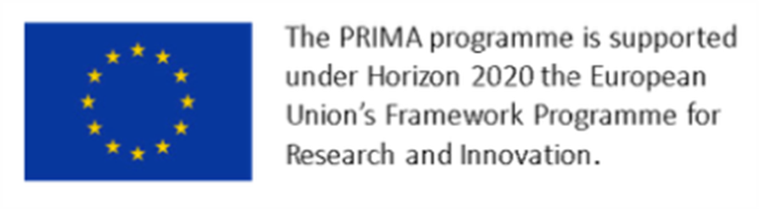

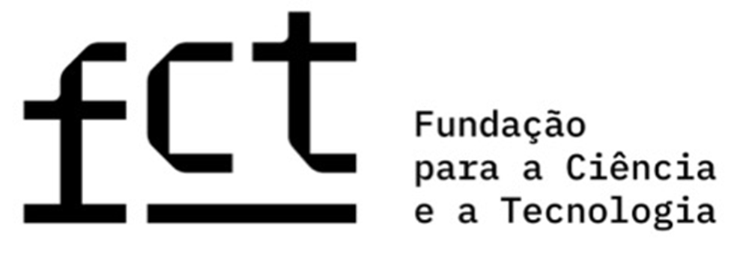





A case study of Carbon and Water Footprint of Higher Education Cafeterias menus from Portugal, Croatia and Turkey
Ada Rocha⁽¹⁾; Beatriz Neto⁽¹⁾; Cláudia Viegas⁽²⁾ ; Derya Dikmen ⁽³⁾ ; Sanja Filipec ⁽⁴⁾ ; Zvonimir Satalic ⁽⁴⁾
⁽¹⁾ Faculdade de Ciências da Nutrição e Alimentação do Porto; Porto, Portugal; adarocha@fcna.up.pt; ⁽²⁾Escola Superior de Saúde de Lisboa; Lisboa, Portugal; ⁽³⁾Hacettepe University; Ankara, Turkey; ⁽⁴⁾ University of Zagreb; Zagreb, Croatia.
INTRODUÇÃO
Higher Education Institutes (HEIs) are strategic settings for driving dietary changes. It is essential that campuses not only expand the availability of health, nutritious meals options in cafeterias, but also promote more sustainable food patterns by discouraging the consumption of unhealthy foods with higher environmental impacts.
In food service units, menu planning is the foundation of the production process, a process that inherently consumes significant natural resources and generates solid and liquid waste. Therefore, assessing the environmental footprint of these menus is a vital step toward promoting sustainability.
OBJETIVO
This study assesses and compares the Carbon and Water footprints of 300 meals from 30 different menus served in university cafeterias across three European countries: Portugal, Croatia, and Turkey.
MÉTODOS
A cross-country assessment was conducted to evaluate the environmental impact of university cafeterias menus.
Sample: 300 individual meals derived from 30 different menus across Portugal, Croatia, and Turkey.
Data Collection: Every menu has two weeks, equivalent to 10 working days, from May and June. In all countries, each meal included one to four main course options, that could be chosen by the consumer (e.g. beef course, seafood course, vegetarian course), and each option was evaluated separately as an independent meal.
The carbon footprint of the menus was assessed using the Life Cycle Assessment (LCA) approach (ISO 14040), the water footprint values for each food item on the menu were determined using the study by Mekonnen and Hoekstra 2011, 2012.
Data was processed using the R software version 4.3.1. Statistical analysis included descriptive statistics, Mann-Whitney, ANOVA for testing for differences among groups, and Spearman correlation. Statistical significance was considered at p < 0.05.
RESULTADOS
Table 1. Carbon and Water footprints results, all countries
 | n | mean | sd | min | Q1 | median | Q3 | max
Water (m3/ton) | 298 | 1785.4 | 909.3 | 362.3 | 1176.4 | 1533.5 | 2221.6 | 6548.3
CO2 (CO2-eq) | 298 | 1.9 | 1.8 | 0.01 | 0.8 | 1.3 | 2.7 | 10.5
Water footprint
x̄ = 1785.411 ± 909.3 m3/ton
Carbon footprint
x̄ = 1.9 kg CO2-eq
Table 2. Carbon and Water footprints results, by country
Turkey
Turkey
 | n | mean | sd | min | Q1 | median | Q3 | max
Water (m3/ton) | 298 | 1785.4 | 909.3 | 362.3 | 1176.4 | 1533.5 | 2221.6 | 6548.3
Croatia | 100 | 1592.9 | 711.2 | 362.3 | 1174.5 | 1411.6 | 1978.8 | 3549.1
Portugal | 98 | 1485.5 | 767.3 | 550.5 | 1017.9 | 1233.9 | 1594.5 | 4467.3
Turkey | 100 | 2271.9 | 1016.1 | 856.7 | 1575.8 | 1999.4 | 2784.7 | 6548.3
CO2 (CO2-eq) | 298 | 1.9 | 1.8 | 0.01 | 0.8 | 1.3 | 2.7 | 10.5
x̄ = 2271.90 ­± 1016.11 m3/ton
x̄ = 2.91 ­± 2.13 kg CO2-eq
Croatia
Croatia
x̄ = 1592.9 ­± 711.2 m3/ton
x̄ = 1.6 ­± 1.4 kg CO2-eq
Portugal
Portugal
x̄ = 1485.46 ­± 767.28 m³/ton
x̄ = 1.42­ ± 1.26 kg CO2-eq
Figura 1. Water Footprint results, by country
Figure 2. Carbon Footprint results, by country
CONCLUSÃO
The findings reveal a complex relationship between Mediterranean Diet (MD) compliance and environmental footprints, with moderate positive correlations observed. These results make the cultural and gastronomic differences of each country evident, encouraging an insightful discussion and enabling the integration of shared learnings and practices to improve menu quality. Ultimately, this study provides valuable insights to develop targeted interventions aimed at optimizing menu options in Higher Education Institute (HEIs) cafeterias and effectively reducing their environmental impact.
REFERÊNCIAS
ISO 14040:2006 environmental management — life cycle assessment — principles and framework [Internet]. Disponível em: https://www.iso.org/obp/ui#iso:std:iso:14040:ed-2:v1:en
Mekonnen, M.M., Hoekstra, A.Y., 2011. The green, blue and grey water footprint of crops and derived crop products. Hydrol. Earth Syst. Sci. 15 (5), 1577–1600.
Mekonnen, M.M., Hoekstra, A.Y., 2012. A global assessment of the water footprint offarm animal products. Ecosystems 15 (3), 401–415.
.Clune, S., Crossin, E., Verghese, K., 2017. Systematic review of greenhouse gas emissions for different fresh food categories. J. Clean. Prod. 1

